Slide 1
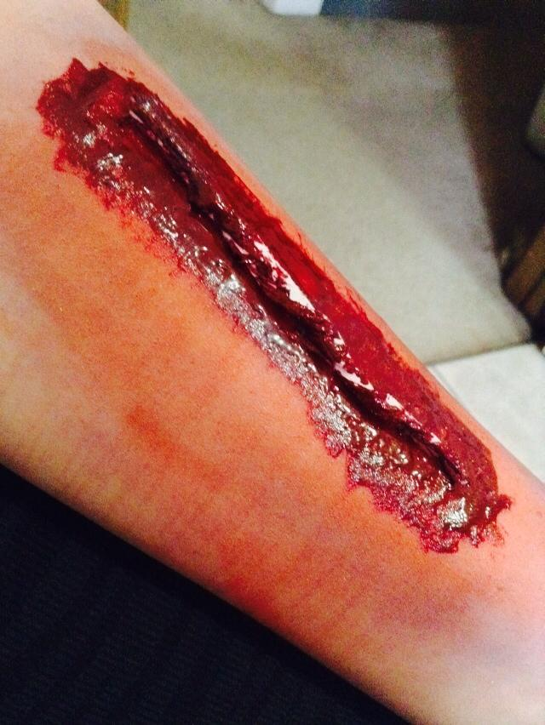
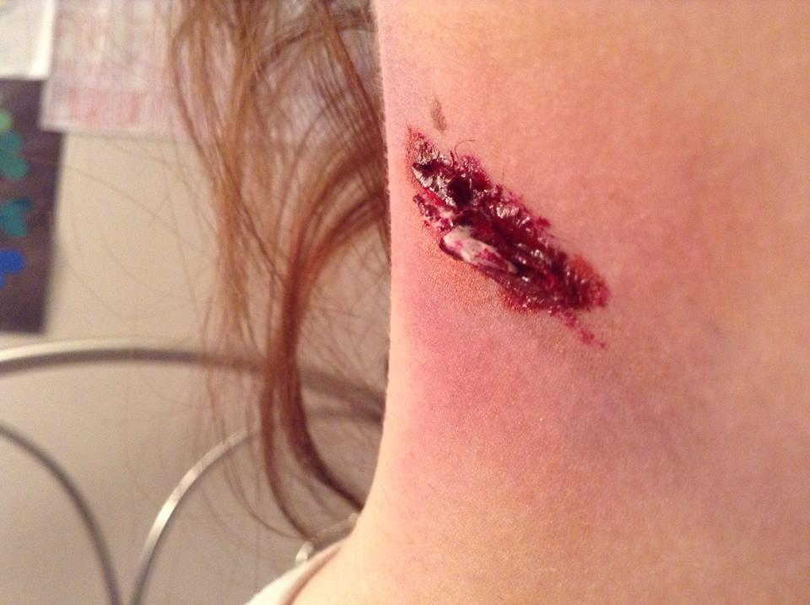
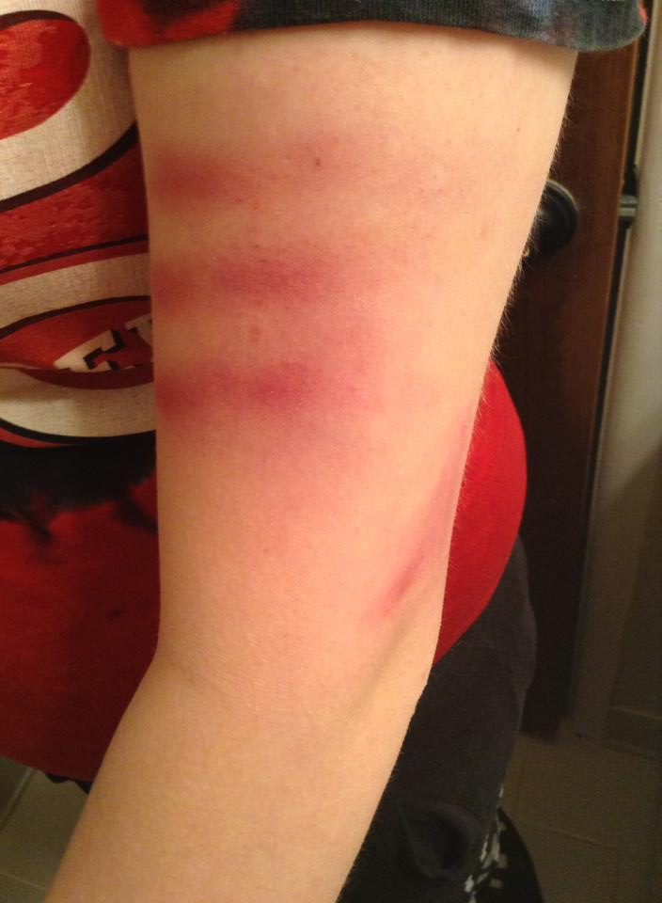
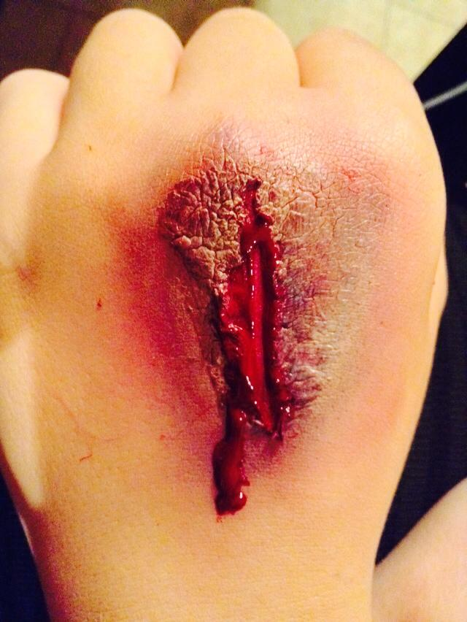
Special Effects Make-up
Career Cluster : Multimedia Artists
Savannah Hemphill
February 12,2014
3rd hour
Career/Technology

Slide 2
Introduction
“Whether I'm wearing lots of makeup or no makeup, I'm always the same person inside. -Lady Gaga”. Makeup is used to enhance your beauty or even sometimes show people the ugly, by design of special effects. I would like to become a Special Effects artist. You can show people not every part of makeup is beauty and with or with out makeup you can still be beautiful and creative.

Slide 3
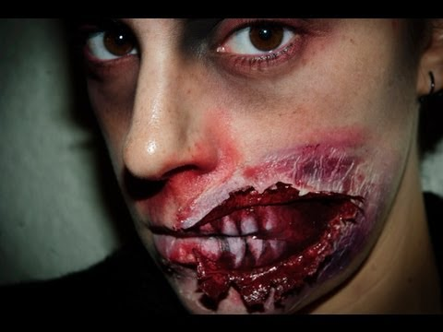
Nature of Work
Work with a team of artists to create a movie, or visual effects
Research upcoming projects to help create realistic designs
Develop storyboards that map out key scenes in animations.
Edit effects on the basis of feedback from directors, other designers , and clients
Meet with clients, designers, directors, and other staff (which may include actors) to review deadlines and development timelines

Slide 4
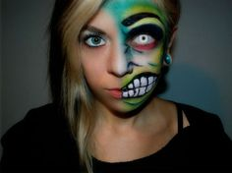
Working Conditions
 Indoor or outdoor: Indoor. I would do the makeup and special effects indoors so no dirt or bacteria gets in the makeup. Also I would not want the winds or other weather conditions messing me up.
 physical : actually working on people and paper for ideas and new ways of learning designs.
Hours : Most likely the hours will be at least 8 to 9 hours a day.
 Can be stressful because if you mess up you will have to do your best to fix it. Also if you are late to the set you could be behind on your work and delay production.

Slide 5
Training, Qualification, Advancement
Degree: bachelor’s degree in fine arts.
Bachelor’s degree programs in art include courses in painting, drawing, and sculpture.
I would like to go to either Michigan State or University of Alabama.
Draw and Design

Slide 6
Job Outlook/Employment
 Employment rate ; 2012-22 - 11%
The employment is increasing/rising.
 I would most likely move to Los Angeles, California because that is where the business of Special Effects is big.
 There isn’t really a specific place I would like to work. I would just like to become a special effects makeup artist and work in Special Effects.

Slide 7
Earnings
Median Salary - $61,370 $29.50 per hour
4 Bed room house +
My own special effects makeup line –
A nice car like a GMC/SUV nothing too fancy +
Nice Fancy Furniture and Flat screens -

Slide 8
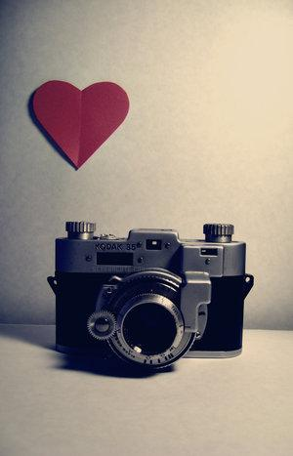
Backup Career.
Use various photographic techniques and equipment, Capture subjects in commercial-quality photographs, Enhance the subject’s appearance with natural or artificial light.
Education: High school diploma or equivalent.
Job outlook- Employment of photographers is projected to grow 4 percent from 2012 to 2022.
Earnings : $28,490 per year, $13.70 per hour.

Slide 9
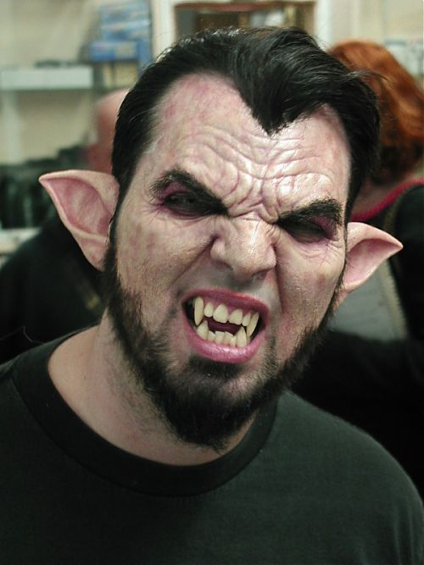
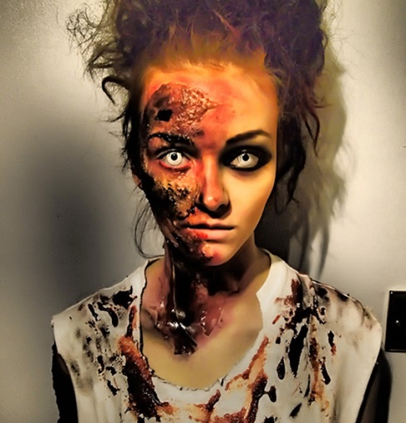
Conclusion
After researching this career I still find myself being interested in this career field. I am so looking forward to learning how to make monsters on human faces and use prosthetics to make zombie faces and other types of creatures. I honestly find how making these creatures and monsters so interesting. However, one thing I may not like about this career is that it is very hard to find certain jobs for what you specialize in. My overall learning experience Is that I would most definitely like to learn a lot more about this business and what I could do to be a professional at this type of artistry/career.

Slide 10
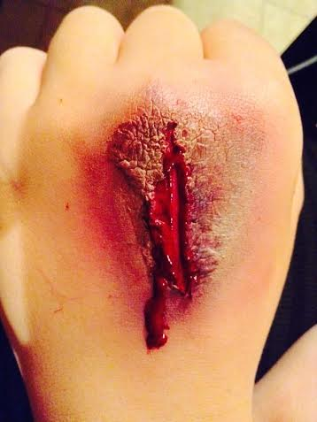
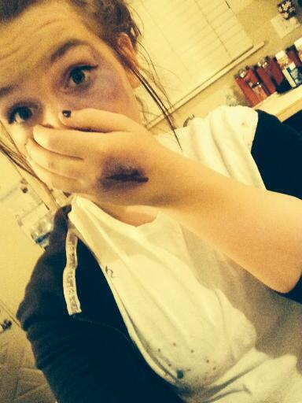
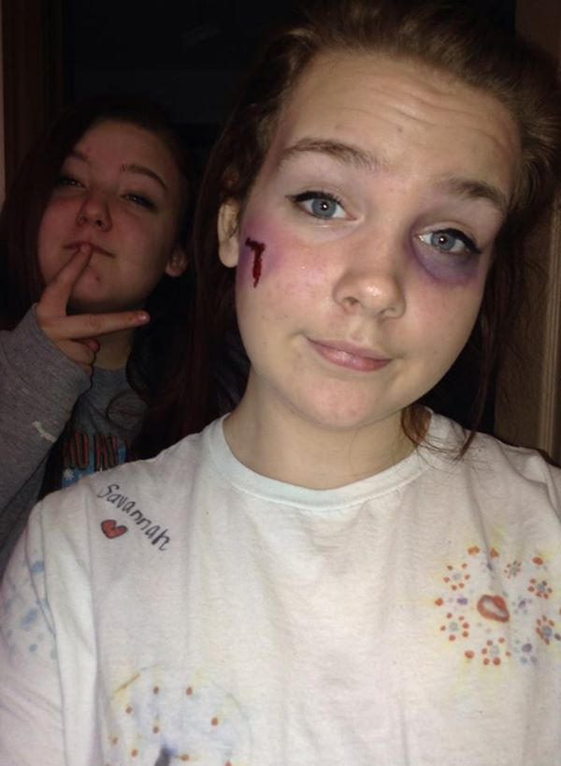
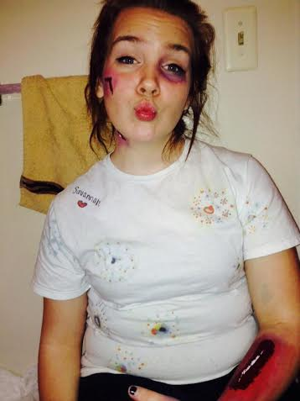
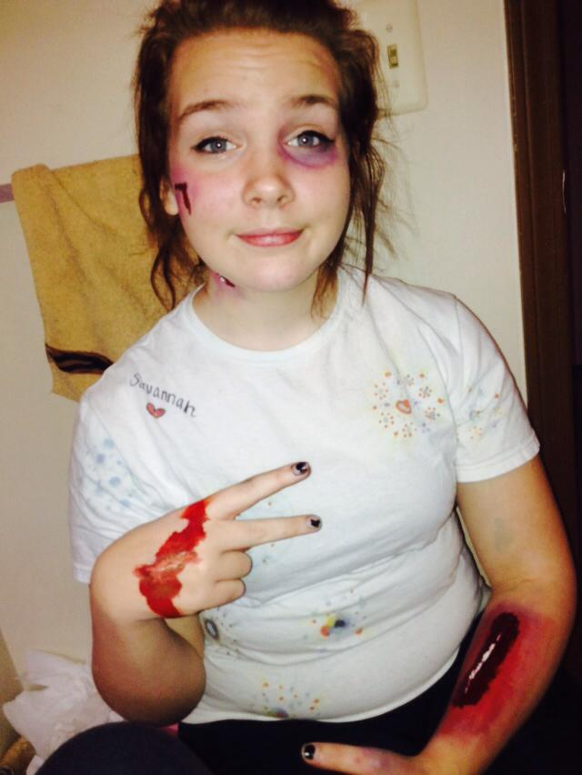
Work Cited.
*Special Thanks To:
Abby Smith for letting me use her as a “test dummy” 
http://www.bls.gov/ooh/arts-and-design/multimedia-artists-and-animators.htm#tab-1

